Slide 1
COMP90054 AI Planning for Autonomy Workshop Week5
Ruixi
huor@student.unimelb.edu.au

Slide 2
Access to Slides:
https://github.com/SiaHuo/COMP90007Workshops
If there is any error in slides, please point it out.
Please refer to solution on LMS for standard answers

Slide 3
Objectives
Week 3
Execution of Heuristic Search Algorithms (A*, WA*, Greedy Best First Search): Fill in the form
4 Properties of Heuristic Search Algorithms and there relationship: safe, goal-aware, consistent, admissible.
State Model
Week 4
Reopen in A*
State Model => Strips
Define Heuristic Function

Slide 4
Objectives
This week
Strips
PDDL

Slide 5

A blocks-world problem
A
A
B
C
B
C
Table
Table
Initial situation
Goal situation
In blocks-world, the agent’s aim is to stack the blocks in one tower with A on B and B on C.
The agent can hold up to one block at a time and can put a block down on the table, or another block.

Slide 6
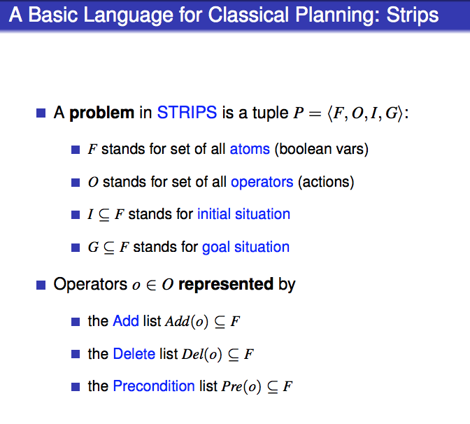

Slide 7
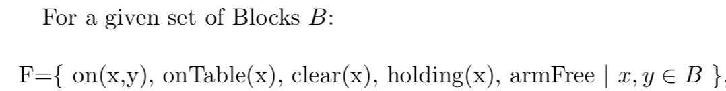
A blocks-world problem
A
C
B
Table
1. Define the set of facts F

Slide 8

A blocks-world problem
1. Define the set of facts F
A
C
B
2. Define operators(actions) O
The agent can hold up to one block at a time and can put a block down on the table, or another block
Table
Just pick up from table:
pickup(x)
Notes:
pickup(pick up from table)

Slide 9



A blocks-world problem
1. Define the set of facts F
A
C
B
2. Define operators(actions) O
The agent can hold up to one block at a time and can put a block down on the table, or another block
Table
Just pick up from table:
pickup(x)
Notes:
pickup(pick up from table)

Slide 10
A blocks-world problem
1. Define the set of facts F
A
C
B
2. Define operators(actions) O
Table
2) Pick up from another block:
unstack (x, y)

Slide 11



A blocks-world problem
1. Define the set of facts F
A
C
B
2. Define operators(actions) O
Table
2) Pick up from another block:
unstack (x, y)

Slide 12



A blocks-world problem
1. Define the set of facts F
B
A
C
2. Define operators(actions) O
Table
3) Put down on table:
putdown (x)

Slide 13



A blocks-world problem
A
1. Define the set of facts F
C
B
2. Define operators(actions) O
Table
4) Put down on another block:
stack (x, y)

Slide 14

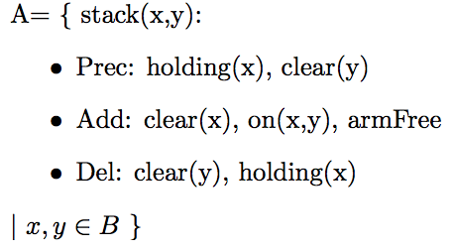
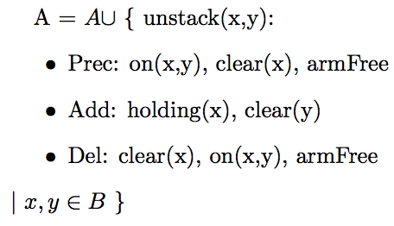
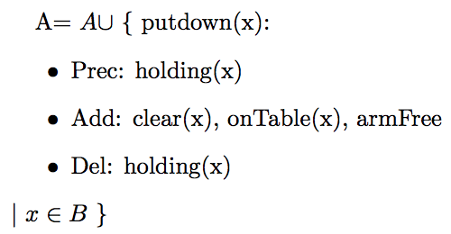
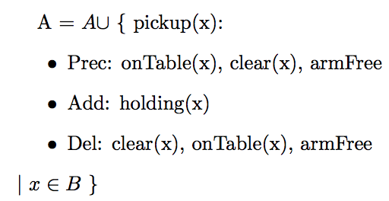

A blocks-world problem
F
A
O
C
B
Table
I
G
G =
Notes:
4 operators here, we can also define this problem using just 2 operators.

Slide 15
2 actions
Blocks-world can be modeled with only 2 actions instead of 4.
The robot can pick up a block and put it down on another block (or the table) in a single action.
2 actions in total:
Move1(Block, FromTable ,ToBlock) and Move2(Block, FromBlock, ToTable)
You now no longer need to keep track of what the robot is holding or if the hand is empty

Slide 16
Objectives
2.PDDL

Slide 17
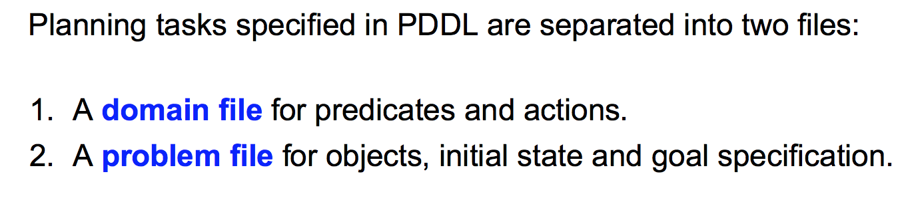
PDDL
A common language for writing STRIPS domain and problem sets is the Planning Domain Definition Language (PDDL).

Slide 18
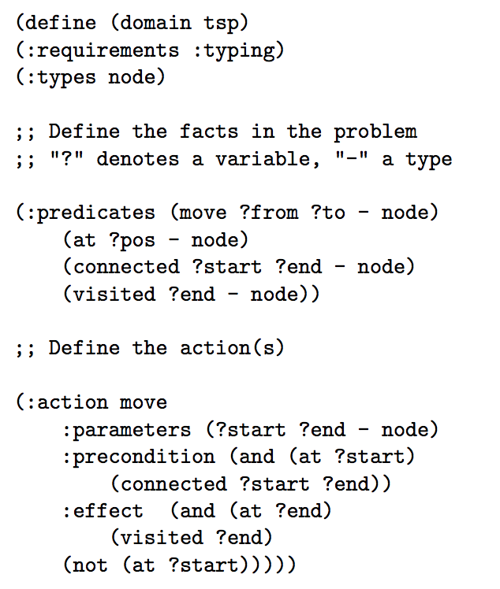
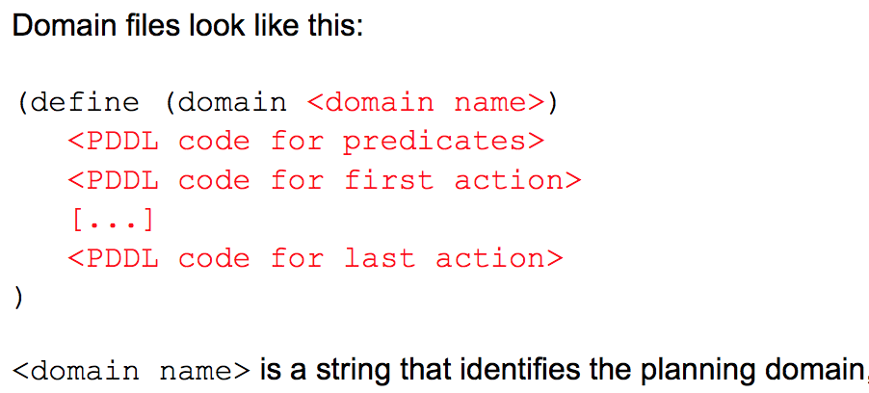
PDDL
Travelling Salesman Problem
1.Domain file

Slide 19
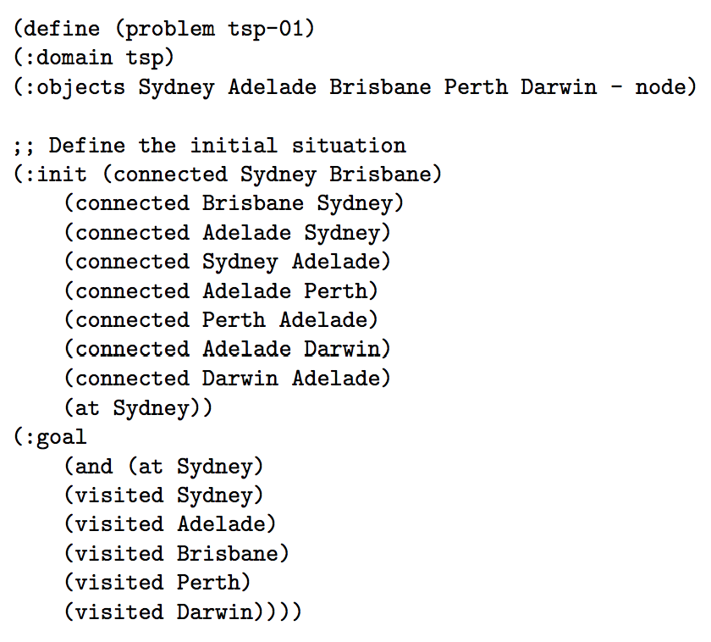
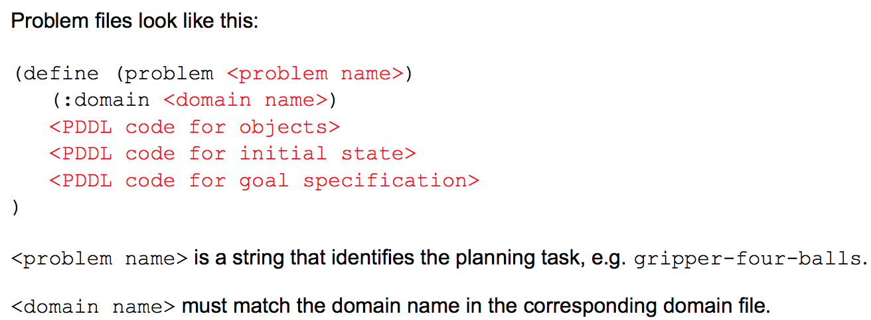
PDDL
Travelling Salesman Problem
2.Problem file

Slide 20
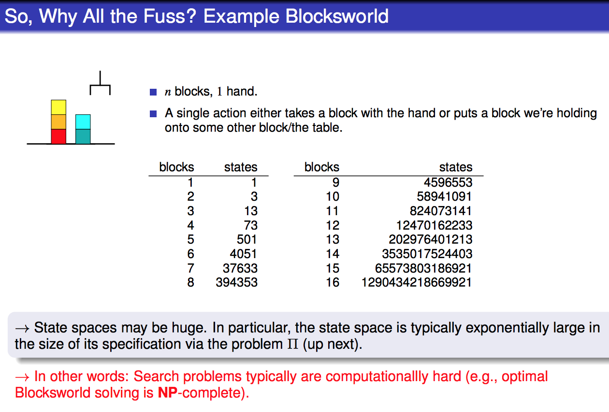

Slide 21
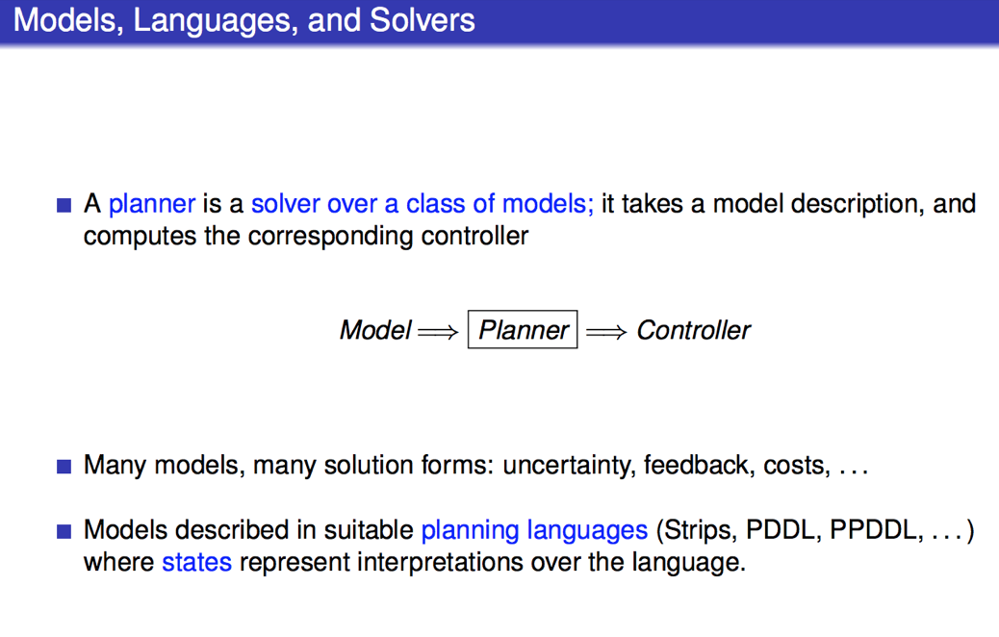

Slide 22
PDDL online editor
http://editor.planning.domains

Slide 23
Solution:
2 actions; 4 actions
http://editor.planning.domains/#read_session= TYXYMCQN8w

Slide 24
